Slide 1




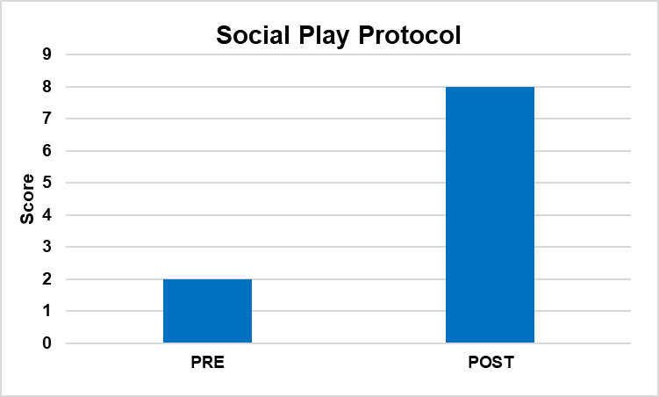
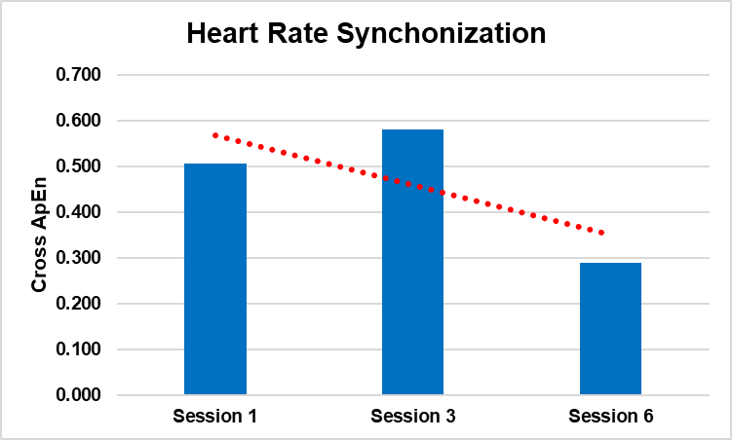
Increased physiological coupling may account for improvement in social behavior in a child with ASD after a 6-week HPOT: a case study
King, K.², Godden, E.², Smith, K.², Peck, K. ¹, Katsavelis, D.³, Almazloum, M.¹, Kyvelidou, A.¹
Department of Physical Therapy, Creighton University, Omaha, NE
Heartland Equine Therapeutic Riding Academy, Gretna, NE
Department of Exercise Science & Pre-Health Professions, Creighton University, Omaha, NE
INTRODUCTION
RESULTS - CONCLUSIONS
ASD has drastically increased in the last decade to 1 in 44 US children¹.
Hippotherapy (HPOT) is a form of therapy for children with ASD that includes physical, occupational or speech therapy while being on a horse.
Studies exploring the reasons why HPOT is effective are lacking and are theoretical rather than experimental.
Humans tend to naturally and freely entrain to other physiological signals in the environment.²
The purpose of this case study was to:
Determine the effects of a 6-week HPOT on movement and social behavior of children with ASD and to investigate the underlying mechanisms of why HPOT is successful for ASD through the coupling of physiological responses between horse and rider.
METHODS
Six-year-old boy medically diagnosed with ASD.
Experimental protocol is presented in Figure 1.
In the pre-assessment he could not stand still to collect postural control. Post-assessment he was able to maintain standing posture for 10 seconds as instructed.
Alertness as perceived by his parents was higher in the post assessment in comparison to the pre-assessment.
A 6-week HPOT brought changes in attention-following and joint attention skills of a 6-year-old boy with ASD.
This experimental protocol may be able to determine the relationship between therapeutic outcomes and heart rate synchronization and provide a new and innovative tool for HPOT efficacy.
Figure 1. Experimental design
Pre and Post Assessments included
  Social play protocol for attention-following and initiating joint attention³
  Postural control (AMTI Force platform)
  Caregiver perception questionnaire
In 3 of the sessions, we assessed
  Heart rate coupling
ACKNOWLEDGEMENTS-REFERENCES
Research reported in this abstract was supported by the National Institute of Health. 1R03HD101115-01
Autism Spectrum Disorder: data and statistics.2022
Smith LB, Thelen E. (1993) A Dynamic Systems Approach to Development: Applications, MIT Press.
Watson, Baranek, & Poston, 2003. University of North Carolina at Chapel Hill.

