Slide 1
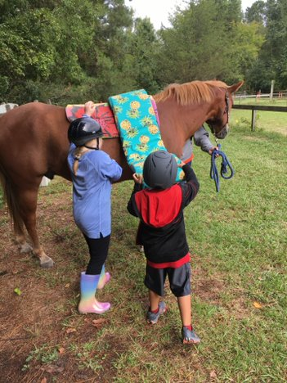
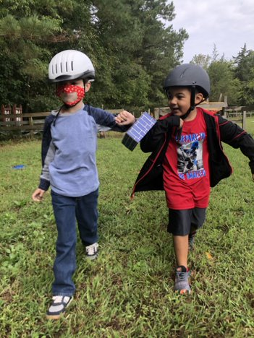
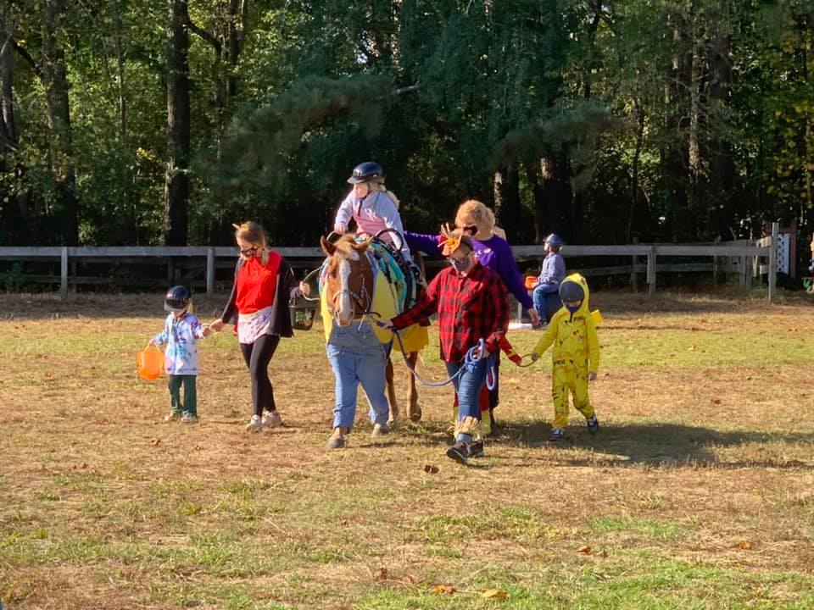
Partners in Interactive Vaulting and Occupational Therapy Program on Executive Function and Social Participation in Children with Disabilities: Outcomes and Future Directions
Heather Panczykowski, DHSc, OTR/L, FAOTA
Purpose of the Study
Description of the Program
The purpose of this study was to examine the influence of a collaborative interactive vaulting occupational therapy program on executive function and social participation in children with developmental disabilities.
Program Description
60-minute, 10-week group session followed the Cognitive Orientation for daily Occupational Performance Model (CO-OP).
Parents and child collaboratively developed two social skills goals for the duration of the program.
Session activities fostered teamwork, verbal and non-verbal communication, information about emotions and strategies for emotional regulation.
Sessions incorporated an overarching theme of the horse as teammate.
Group Structure
Participants “checked-in” to review their goals prior to group activities
Session activities included horse grooming and leading, group games and activities, and practicing vaulting maneuvers on both the barrel and horse.
Participants “checked-out” at the end of each session to review goals and discuss their performance.
Literature and Background
Children with developmental disorders often present with challenges in executive function (EF), which affects emotional regulation, problem-solving, and social skills. Despite the compelling need for social skill acquisition in children with emotional and behavioral disorders, there is a lack of accessible social opportunities (Taheri et al., 2016) and social skills programs to help children acquire these skills (Radley, et al., 2014). These barriers have galvanized parents to look for complementary approaches, such as adaptive riding to foster social development (Christon, Mackintosh & Myers, 2010 & Huang, Seshadri, Matthews, & Ostfield, 2013). There is preliminary evidence that adaptive riding has been successful in decreasing inattention/ hyperactivity, irritability, and social problems such as not having a good relationship with peers (Cuypers, et al., 2011; Gabriels, et al., 2018). However, research has not explored the impact of a collaborative interactive vaulting occupational therapy program on children's’ executive functioning and social participation.
Results
Interactive Vaulting Instructor Rating Results on the BRIEF-2
Statistically significant improvements in the children’s ability to inhibit and stop behaviors at the appropriate time, initiate and stay on tasks, and shift their attention when needed. The ability to control emotions also drastically improved.
Parent Rating Results on the BRIEF-2 did not reveal significant improvements in behavior.
Social Profile Results Scored by Research Team
Statistically significant improvements were noted in the children’s activity participation, social interaction, and ability to engage in group member roles skills at the associative and basic cooperative group levels.
Research Design
Research Design:
This quasi- experimental pilot study utilized a one-group pretest-posttest design.
Executive functioning was measured using Parent and Teacher rating scales using the Behavioral Rating Inventory of Executive Function, 2nd edition
(BRIEF-2).
Social participation was measured by the Social Profile.
Participants:
Ten males, five females; Mean age 8.6 years, SD 2.64 years.
Data Analysis
Paired sample t-tests examined changes in pre-test to post-test parent and teacher BRIEF-2 scores; Wilcoxon Signed Ranks tests examined changes in pre-test to post-test Social Profile scores.
Discussion and Limitations
Although this study had a small sample size and should be interpreted with caution, these results indicate potential for social emotional and growth for children with disabilities. However, the contrasting performance perceptions of the parents and the Interactive Vaulting instructor indicate that the skills learned in the group were not generalized to other settings. Further iterations of the program may include a parent education component of the strategies utilized in the group to incorporate the social skills goals into the child’s daily routine.
Special thanks to Sherri Moore of Moonbeams and Miracles Therapeutic Horsemanship Center, Grimesland, NC
Panczykowskih17@ecu.edu

