Slide 1


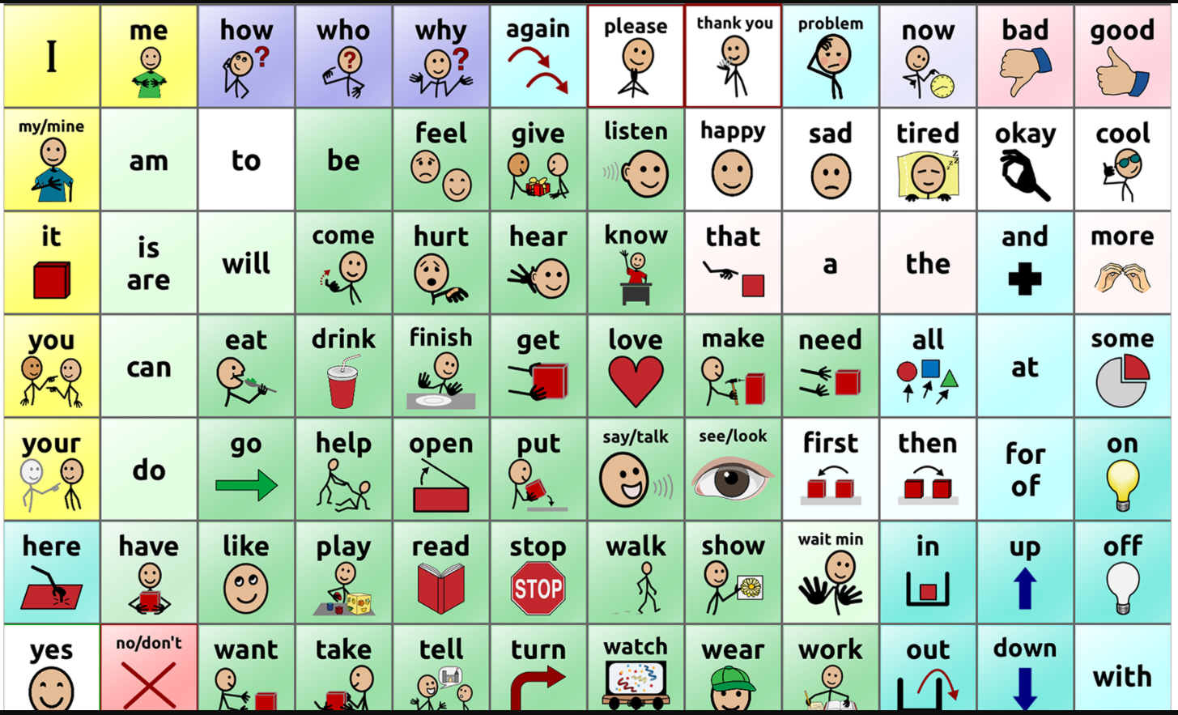
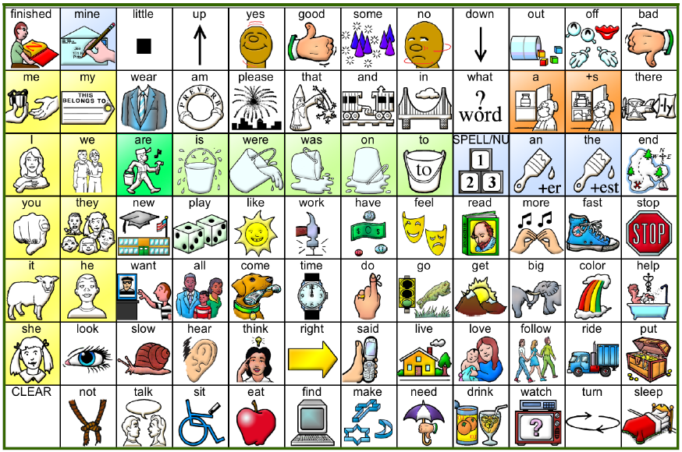
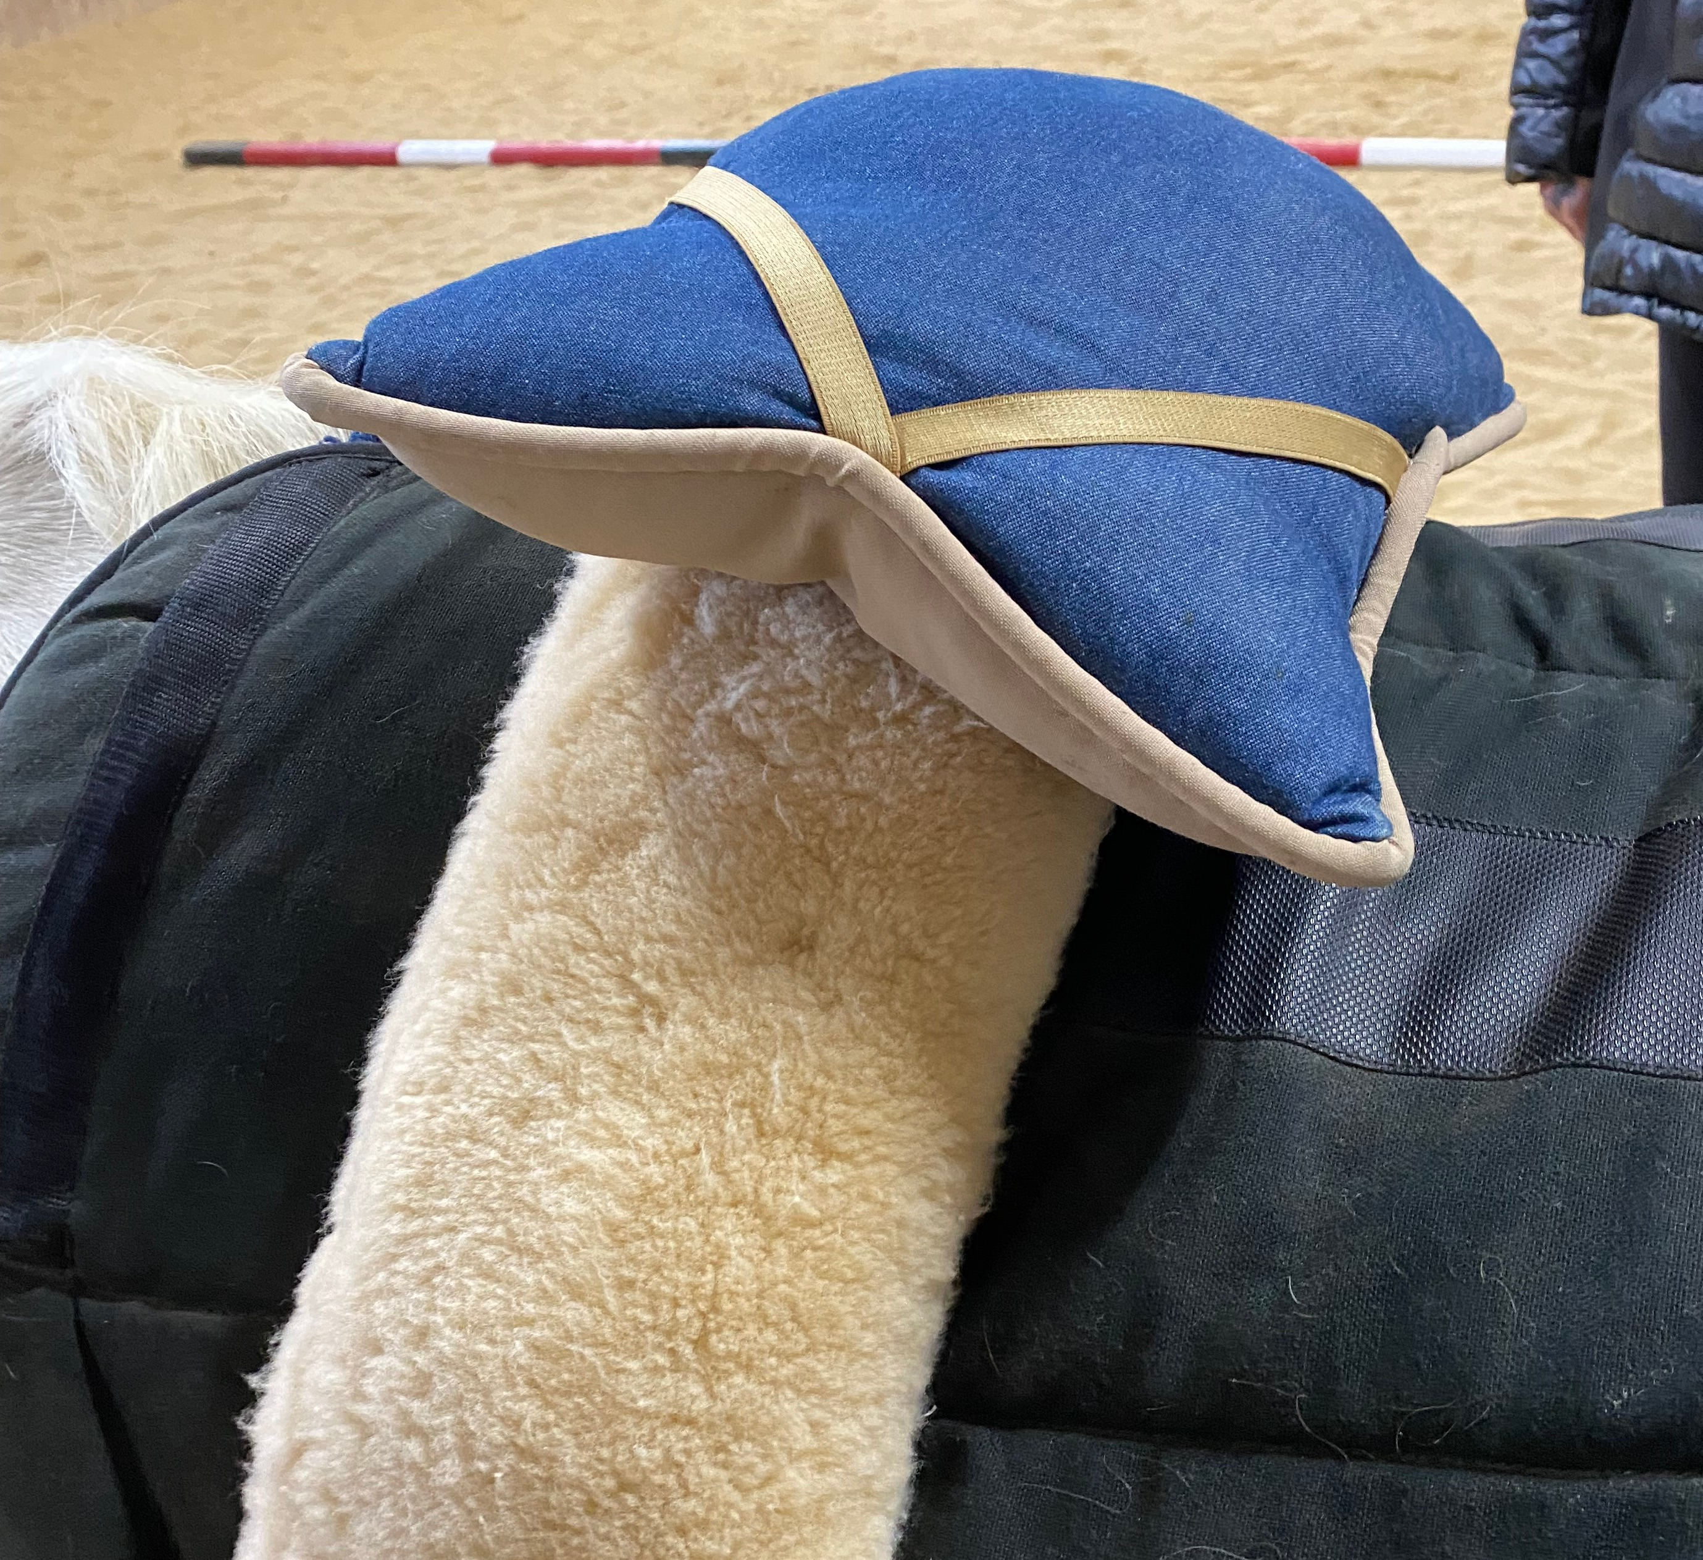
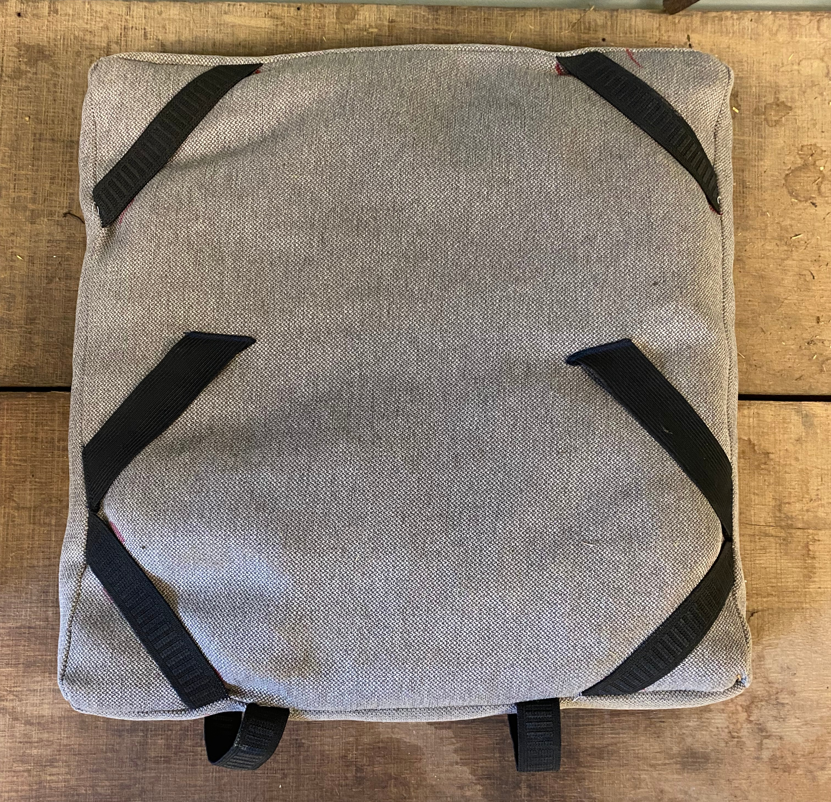
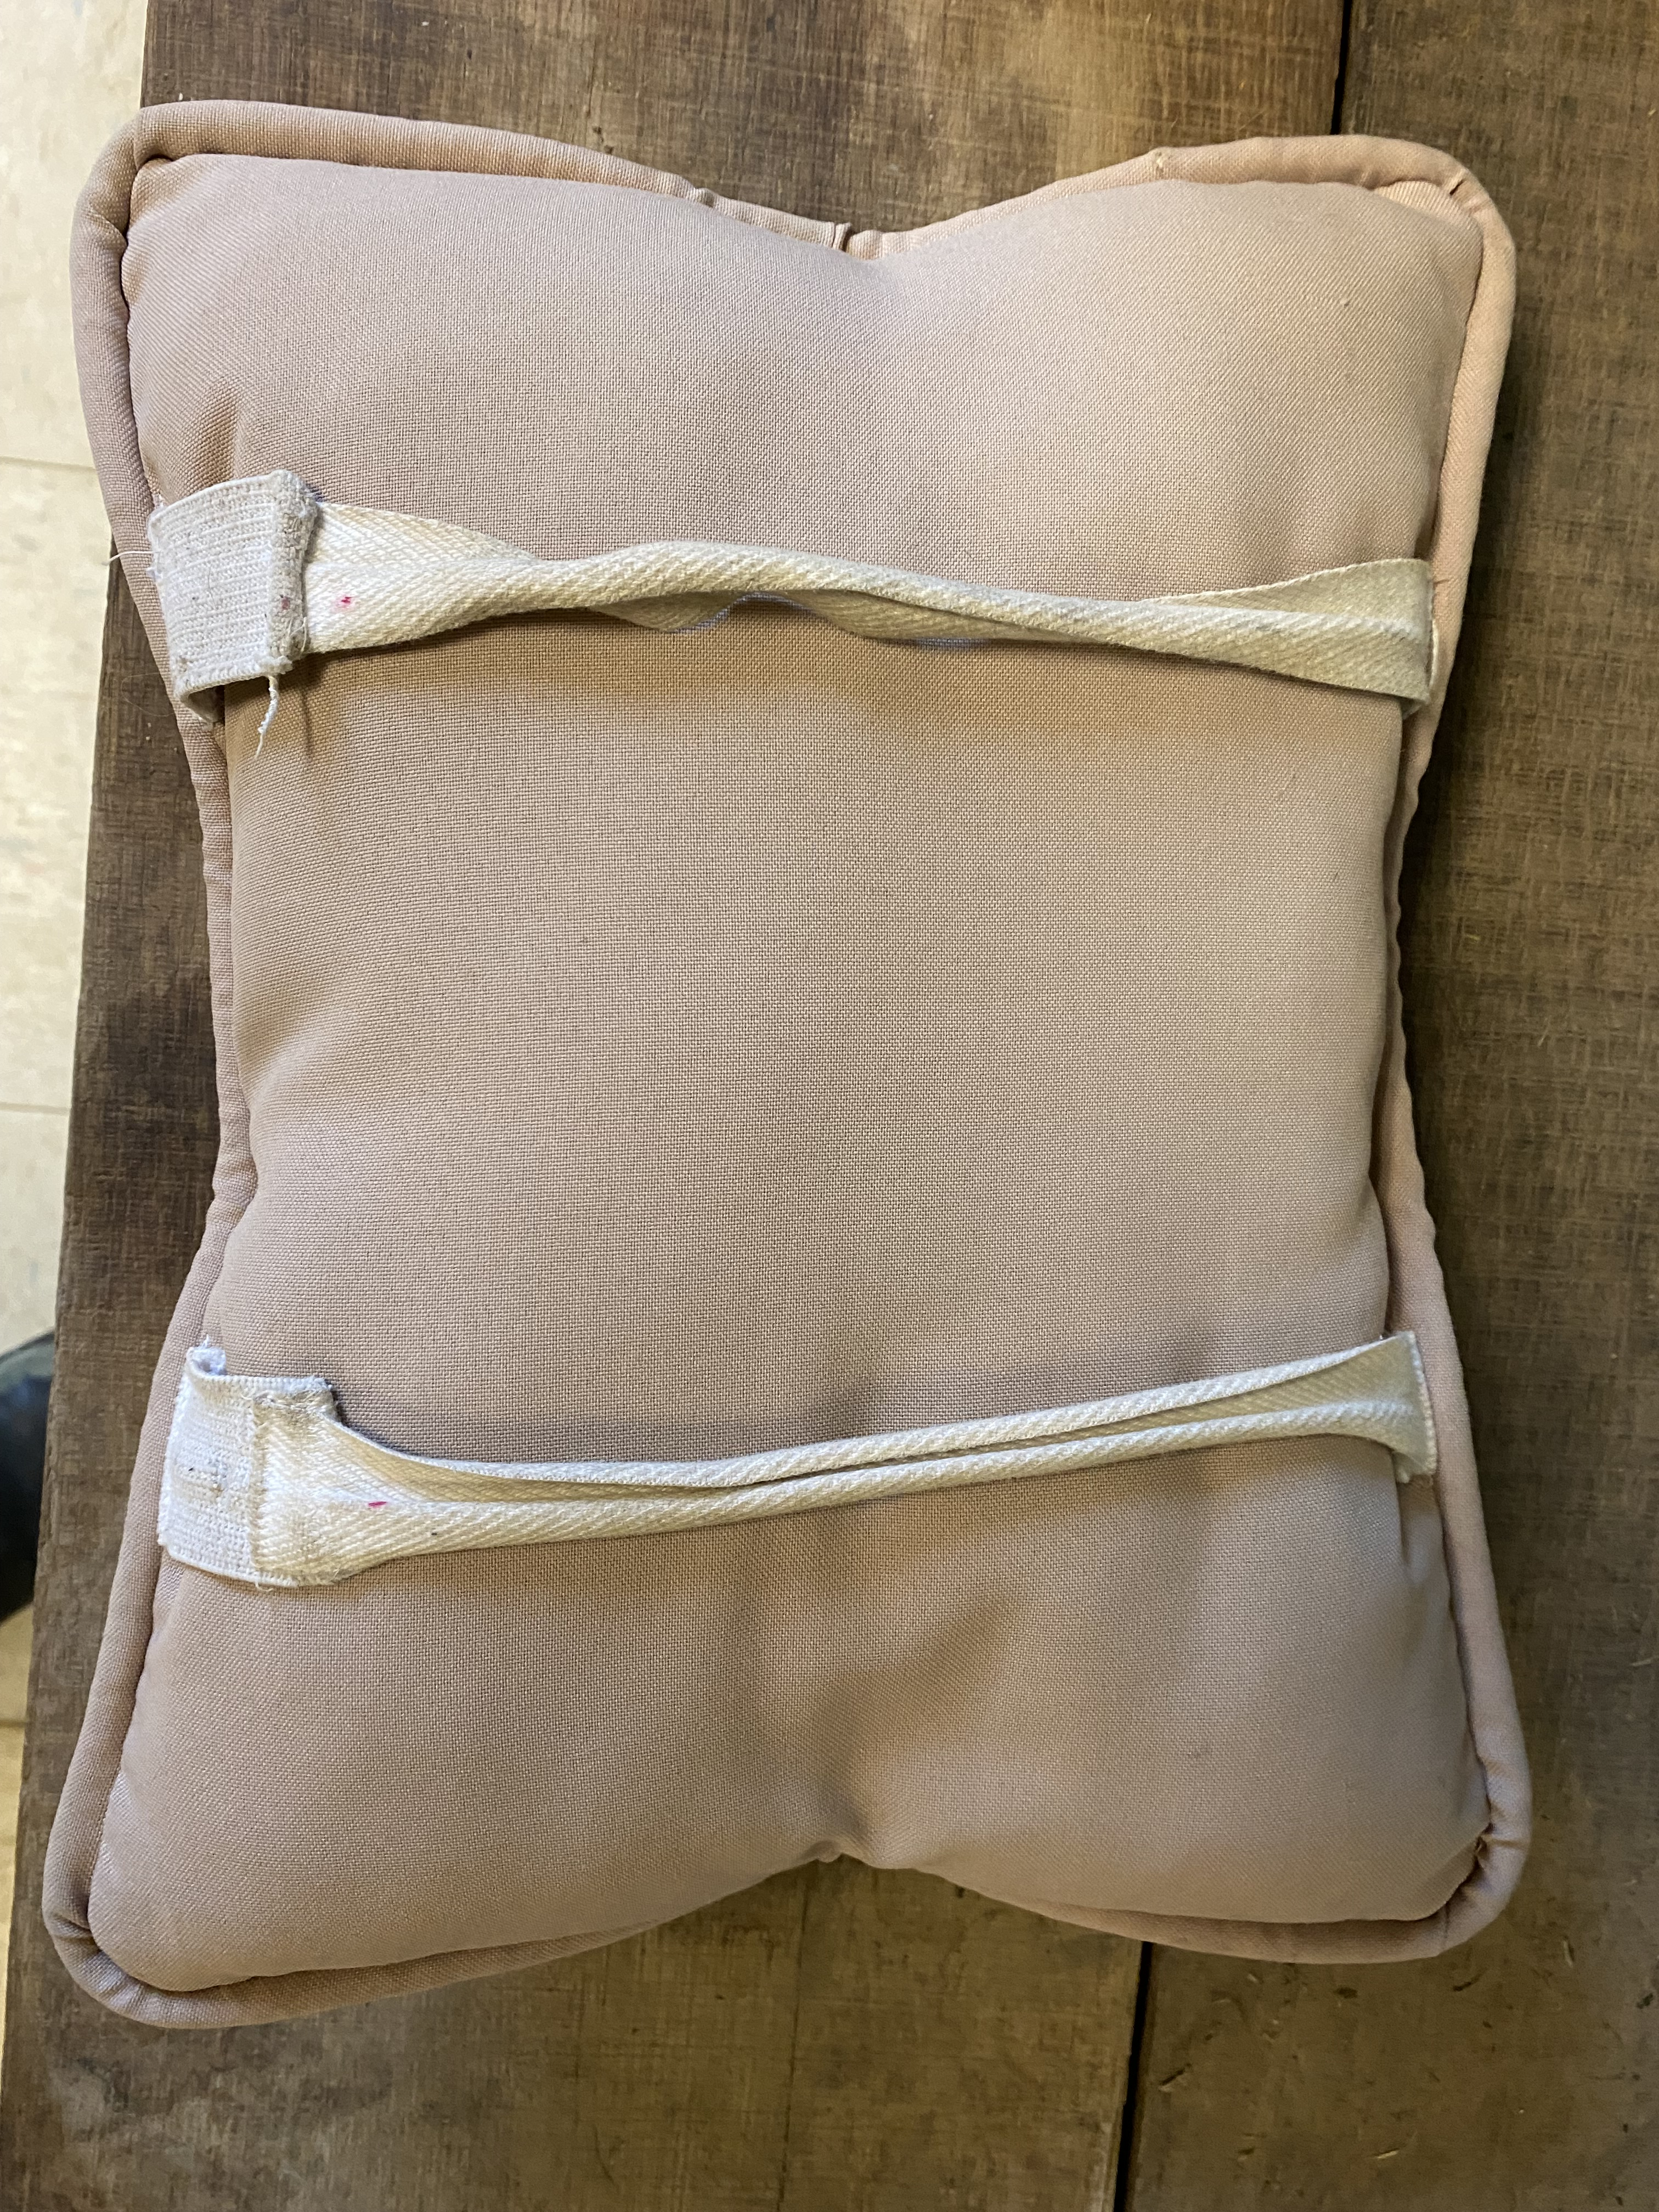
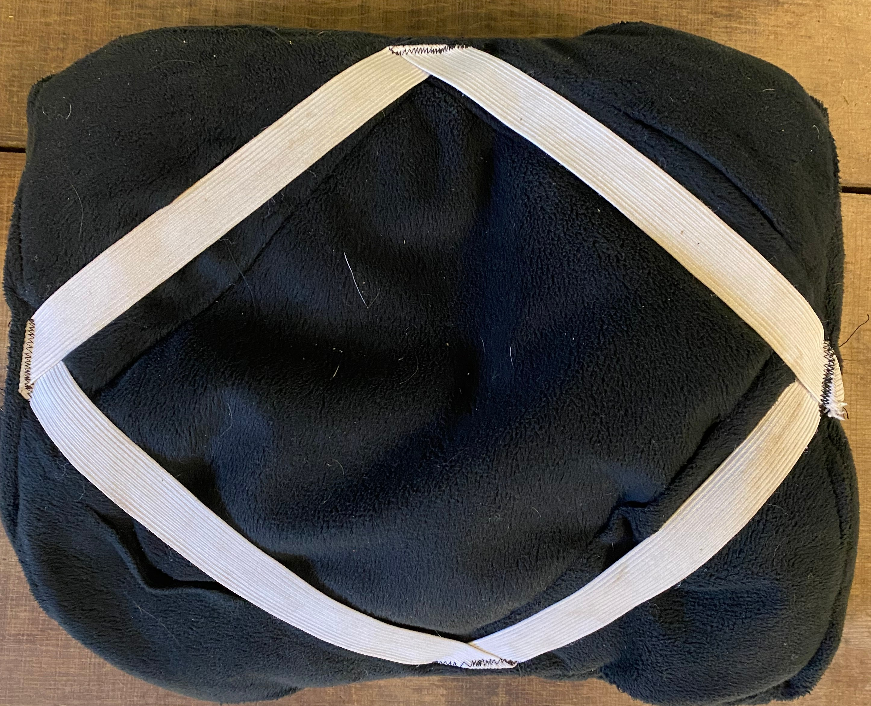
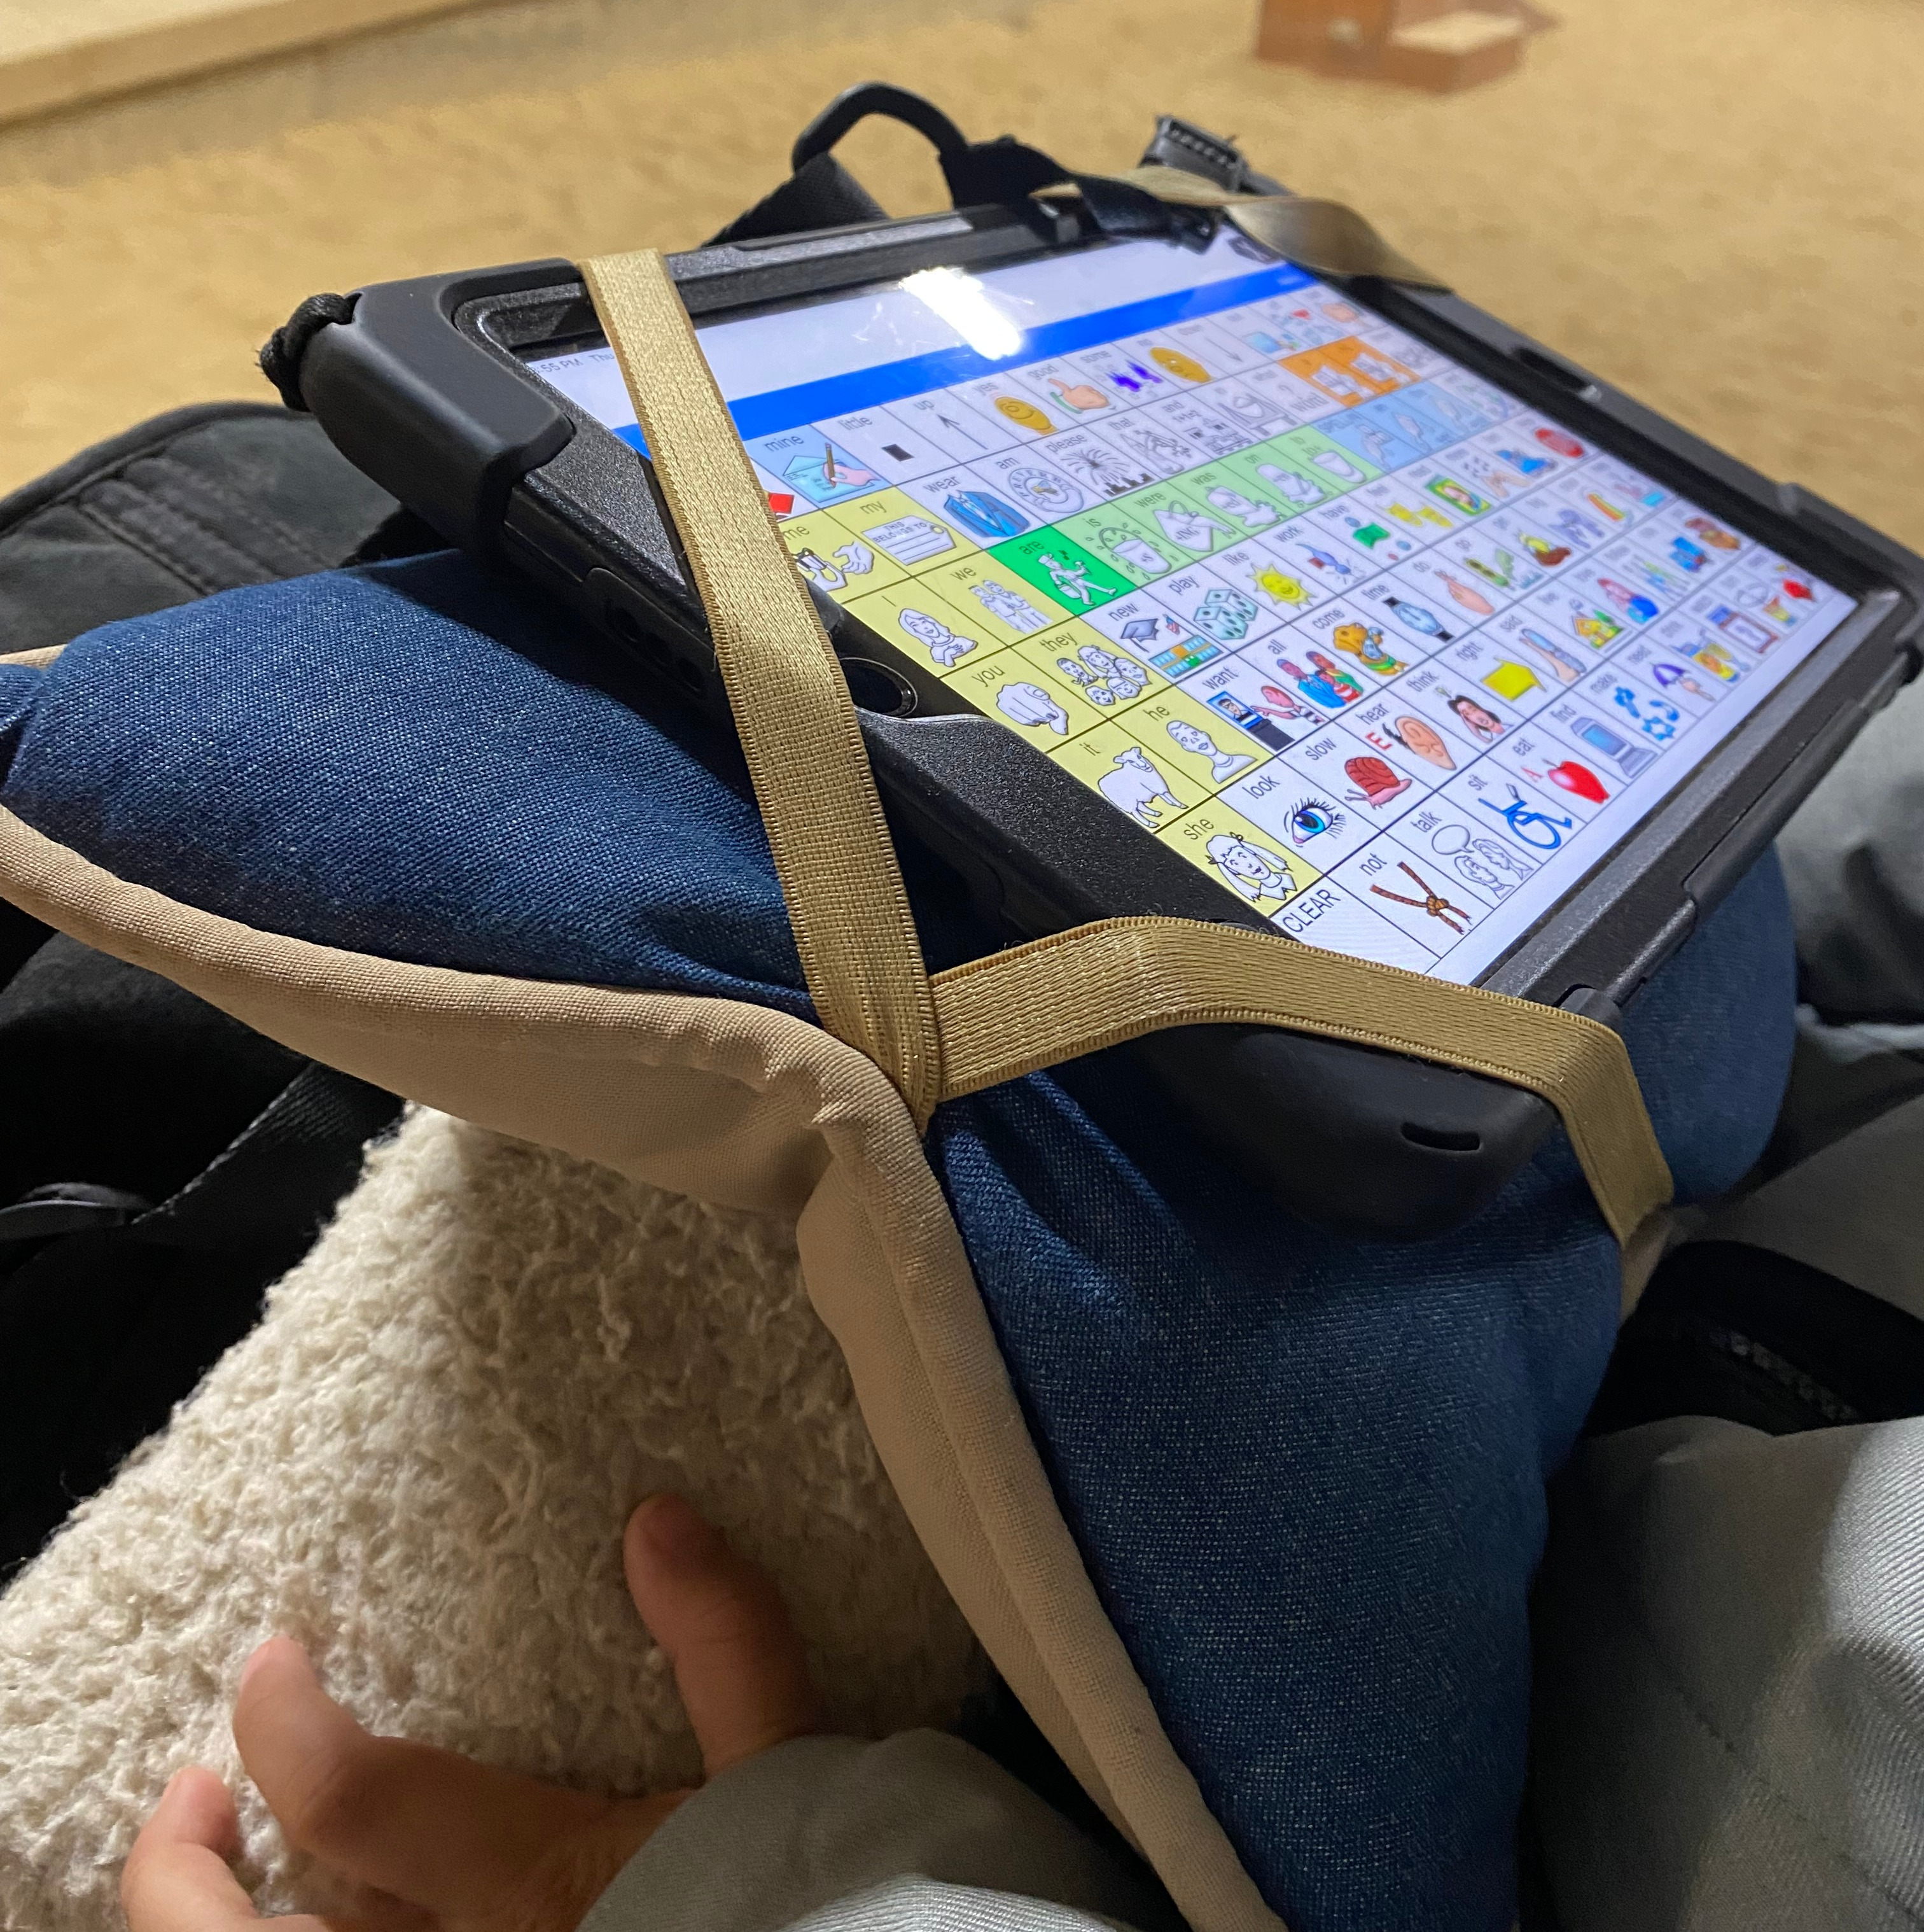
The feasibility of an adaptive pillow to enable AAC use during hippotherapy-incorporated speech-language intervention sessions
Anna Cannone, MA, CCC-SLP, Allison Gladfelter, PhD, CCC-SLP, Emma Sergeant
School of Allied Health and Communicative Disorders, College of Health and Human Sciences, Northern Illinois University
Introduction
Children with complex communication and sensory needs often participate in speech-language therapy sessions that incorporate hippotherapy as a tool to enhance therapy outcomes (Macauley & Gutierrez, 2021; Maldonado, 2021). For children with complex communication needs, the consistent use of augmentative or alternative communication (AAC), such as a dedicated speech-generating device (SGD) or an iPad with an AAC application, increases their functional and spontaneous communication and comprehension of language (Bedwani, et al., 2015).
Incorporating hippotherapy and AAC presents challenges in terms of managing additional technology that preserves the reliability of therapy and does not interfere with the horse. In this feasibility study, we explored how adapting a pillow to securely mount the clients’ AAC devices without harming the horse could allow participants to continue accessing their AAC system throughout the mounted time.
We then tracked the participants’ pre-selected language goals across 14-months to see if the ability to access their AAC device during sessions incorporating hippotherapy improved their communication skills.
AAC Systems
Multi-modal communication including SGDs, oral speech, or a combination were used to enhance language comprehension and language production (Allen et al. 2017; O’Neill, Light, & Pope, 2018; Sennot, Light, & McNaughton, 2016).
Adaptive Pillows
3 pillows (mini, standard, large) were created using soft, durable upholstery material, which supported the SGDs for user access and alleviated physical pressure on the horse
Elastic straps were attached across all corners of each pillow to easily place and remove devices
Longer straps were attached on the backs of all pillows to secure them to the surcingle, which further protected and held the device to the horse
Procedure
Participants attended weekly, hippotherapy-incorporated sessions for 14-months
Session activities included structured conversation, directing the horse’s movements, planning the session, literacy, engaging in motivating activities, and embracing language-rich moments
The primary investigator used aided language input, recasting, expansion, and other evidence-based language strategies to facilitate language comprehension and production (Allen et al. 2017; O’Neill, Light, & Pope, 2018; Sennot, Light, & McNaughton, 2016)
Analysis
Language sampling analysis was used due to its functional nature, ecological validity, and flexibility (Spencer, Bryant, & Colyvas, 2020)
Audio recordings of participant’s narrative retelling of 'One Frog Too Many' were collected at baseline, following return from the COVID-19 shutdown, and at the end of the study
Recordings were deidentified and stored in a secure, password-protected OneDrive folder
Samples were coded in the Systematic Analysis of Language Transcripts (SALT) (Miller & Iglesias, 2010)
Results
Question 1: Is it feasible for children with complex communication needs to access their AAC systems during sessions that incorporate hippotherapy with the use of an adaptive pillow?
All participants had full access to AAC
Adaptive pillows were used in 100% of data tracked sessions
No noted ill-effects to the horse
Full access to AAC systems during hippotherapy-incorporated speech-language sessions was deemed feasible
Question 2: Do children who have full access to their AAC systems during hippotherapy-incorporated sessions show gains in communication skills?
All participants made notable gains in overall communication skills
Discussion
The consistent use of one’s AAC system is essential for increasing functional and spontaneous communication and comprehension of language in children with complex communication needs (Bedwani, et al., 2015).
Prior to the use of the adaptive pillow, access to AAC systems during sessions that incorporate hippotherapy has been difficult due to the challenges of safely securing devices in a way that is accessible to clients and their clinicians without putting the horse at risk of discomfort or injury. Often, the alternative is to only provide clients access to low-technology visual supports, access to AAC devices when the horse has stopped moving or exclude the AAC device from on-horse activity entirely.
This study demonstrated that the use of adaptive pillows to secure clients’ AAC systems to the horse was not only feasible, but that clients also made notable gains on their speech/language goals when they were provided access to their AAC devices during the entirety of the session.
ID | Goal area | Baseline data | Final data
A1 | Past tense -ed | 0% | 40%
A5 | Auxiliary “be” | 66% | 85%
A6 | 2-word productions | 1 instance | 5 instances
A7 | Object description | 0 instances | 1 verb with multiple verbal cues
A8 | 2-word productions | 3 instances | 24 instances
Retrieved https://saltillo.com/chatcorner/content/29
Research Questions
Is it feasible for children with complex communication needs to access their AAC systems during sessions that incorporate hippotherapy with the use of an adaptive pillow?
Do children who have full access to their AAC systems during hippotherapy-incorporated sessions show gains in communication skills?
Retrieved from https://lampwflapp.com/
Methods
Participants
ID (Sex) | Diagnosis | Age | Communication device
A1 (M) | Congenital Disorder of Glycosylation | 13 | iPad Air with TouchChat on a 12.9-inch LCD display screen
A5 (M) | Autism Spectrum Disorder (ASD) | 3 | iPad with LAMP Words for Life on 10.2-inch LCD display screen
A6 (F) | Cerebral Palsy | 9 | iPad with Snap + Core on 10.2-inch LCD display screen with a keyguard and wheelchair mount
A7 (F) | ASD, Childhood Apraxia of Speech (CAS) | 7 | iPad Mini with TouchChat on a 7.9-inch LCD display screen
A8 (M) | Rubinstein-Taybi syndrome | 19 | iPad with TouchChat on a 10.2-inch LCD display screen
Acknowledgements & Disclosures
We are grateful for Kristin Cordell, the volunteers, participants, and their families for making this research possible.
Allison Gladfelter and Anna Cannone are salaried employees of NIU. Anna Cannone is an independent contractor working at an outpatient facility that incorporates hippotherapy. There are no other financial or non-financial relationships to disclose.
Standard size AAC pillow without AAC Device
Large AAC pillow without AAC Device
Reverse side of standard size pillow
Mini AAC pillow without AAC Device
Standard size iPad pillow with AAC device

